Slide 1
Numerical Method ICE2142
Mursheda Nusrat Della
Lecturer
Dept. of ICE
BAUET
Lab 1

Slide 2
Reference
Numerical methods, “E Balagurusamy”
Download from internet .This book pdf is available in internet.

Slide 3
Roots of nonlinear equation(p121)
Matheamtical model of science and engineering is of the form f(x)=0
These equation belong to one of the following types of equations
i.Algebric equations
ii.Polynomial equations
iii.Transdental equations

Slide 4
Algebric equations: 3x+5y-2=0(linear)
3x+5xy-2=0(non linear)
(non linear)
Polynomial equation:
Transdental equation 2sinx-x=0

Slide 5
There are number of ways to find the roots of nonlinear equations
i.Direct analytical methods
ii.Graphical methods
iii.Trial and error methods
iv.Iterative methods

Slide 6
Iterative methods grouped into two categories
Bracketing method
Open end method
Bracketing method known as the interpolation method. Reduce the width of the bracket.Has two categories
i. Bisection method
ii. False position method

Slide 7
Open end method known as the extrapolation method use a single starting value or two values that do not necessarily bracket the root.
i.Newton raphsan method
ii.Secant method
iii.Muller’s method
iv.Bairstow method
v.Fixed point method

Slide 8
Bisection method
Also known as binary chopping or half interval method.
If f(x) is real and continuous in the interval a<x<b and f(a) and f(b) are of opposite sign
That is f(a)f(b)<0 then there is at least one real root in the interval between a and b.
Let and Let us define another point to be the midpoint between a and b

Slide 9
Bisection method continue
Now there exist possible three conditions
i.if f( ) =0 we have a root at
ii. If there is a root
between and
iii. If there is a root between
and

Slide 10
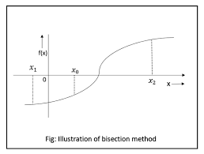

Slide 11
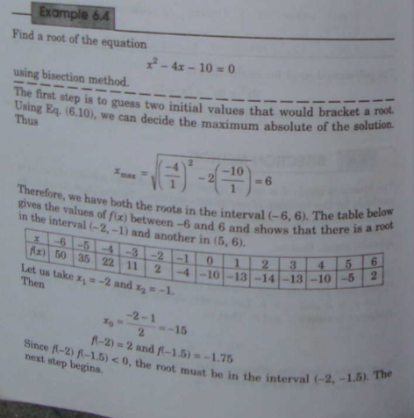

Slide 12
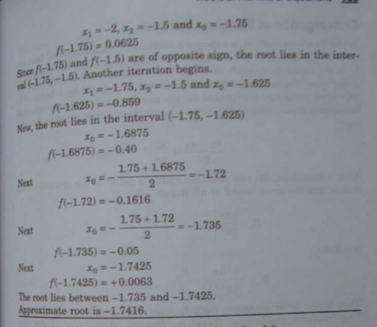

Slide 13
